Slide 1
Lecture 1: Course overview
Due by class: Questionnaire on Canvas
Due by class: Read syllabus
CIS 240: MICROCOMPUTER ARCHITECTURE & PROGRAMMING
1/22/2025

Slide 2
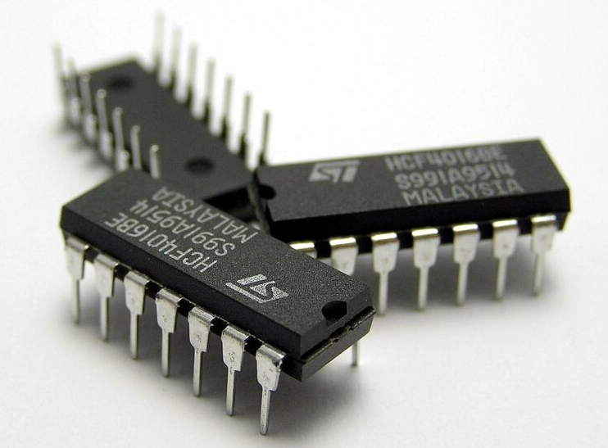
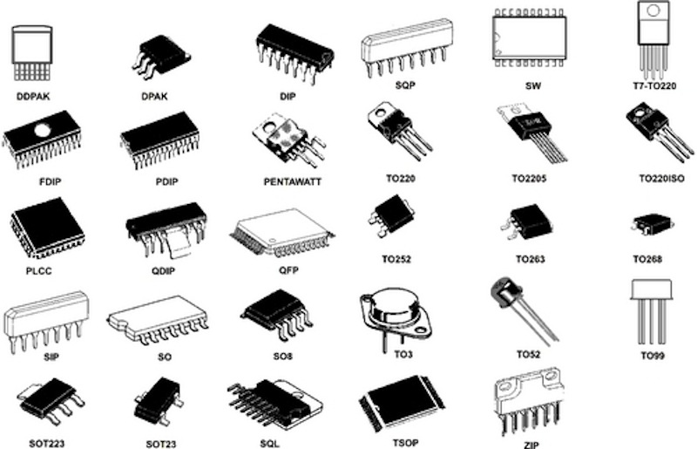
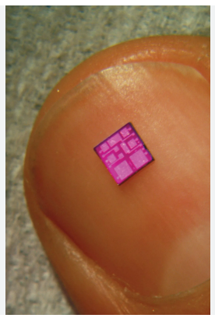
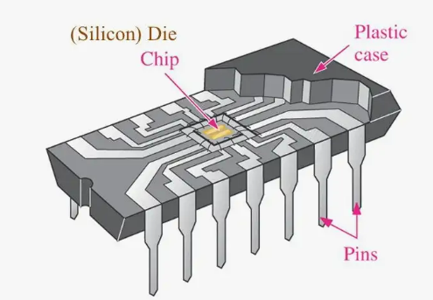
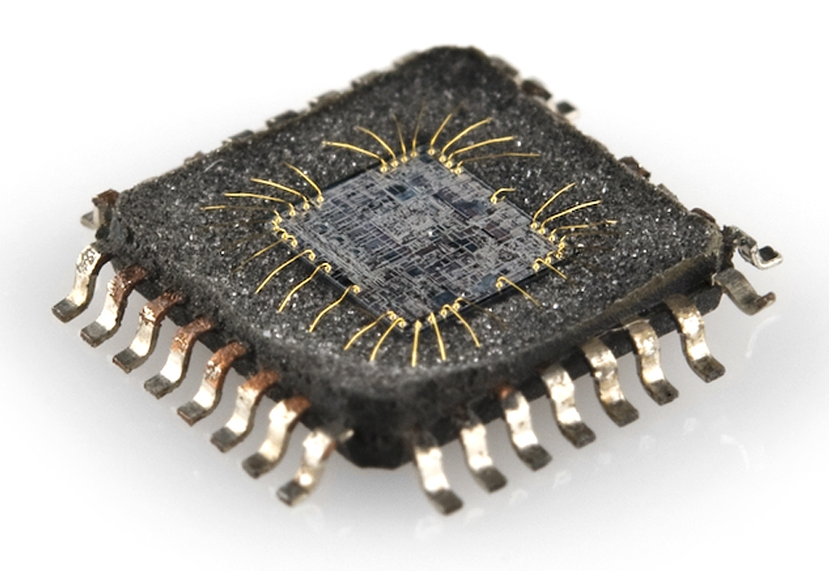
Me: I’m Tina
My specialties:
Integrated circuits
Medical technology
Digital systems

Slide 3
You
If you don’t see why we’re doing something, or where it’s useful, ASK!
If debugging hits a wall, email me! (Maybe 30 minutes if not making progress)
I can meet for office hours at almost any time. If scheduled OH don’t work for you, please tell me! And we can find a better time for you.
I prefer you turning something in over me just taking off points. If you can’t get an assignment in on-time, tell me and we’ll work something out.

Slide 4
Syllabus questions?

Slide 5
Questionnaire stuff

Slide 6
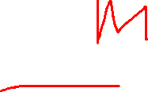
Homework
Monday | Tuesday | Wednesday | Thursday | Friday | Saturday | Sunday
5 |  |  |  | 3 |  | 10
11:59pm
Not Monday x 2
Not TuTh

Slide 7

Office hours: In-person
TuTh after 2pm
TuTh 10am
Mornings
After 6pm
4-6pm, MW
Not TuTh12:30-2
Mornings
Weekends
TuTh10-3
Virtual 8-9pm
 | Monday | Tuesday | Wednesday | Thursday | Friday | Sat | Sun
10am | 13 |  | 13
11am |  |  |  |  | 1
Noon |  | 1 |  | 1 | 1
1:20pm | 12 |  | 12
2pm | 1
3pm
4pm
5pm
This day | 1 | 9 | 1 | 8 | 12

Slide 8
Textbook
Bait and switch
Post Cuesta: 1 industry, 1for fun, the rest 4-year

Slide 9
Interests
Security (memory unsafe. Memory safe languages include Rust, Go, C#, Java, Swift, Python, and JavaScript.)
Gamesx3
Not interested much in this class. Let me program.
Hands on work
Bit manipulation
Memory (Stack, etc.)
Concurrency (Threads, locks…)
Mojo programming language

Slide 10
Canvas

Slide 11
Today
Lecture:
Course overview → “Let’s build a computer”
Goal: Make sure you know what we’re talking about when we talk about “computer architecture”.
Numbers
Lab: Numbers practice (Homework will also be number practice)

Slide 12
Computer hardware…
https://www.pcmag.com/how-to/how-to-build-a-pc-the-ultimate-beginners-guide

Slide 13
What kind of computer?

Slide 14
Things to buy
Case
Motherboard
Processor (CPU)
Cooling
Memory
Storage drives
Power supply
(Graphics card)
(WiFi card if not built-in to motherboard or using dongle)
Display, keyboard, mouse, speakers, …

Slide 15
PC case:
For example: CORSAIR: https://www.corsair.com/us/en/s/pc-case-comparison?_gl=1*wswpfc*_up*MQ..*_gs*MQ..&gclid=Cj0KCQjw_qexBhCoARIsAFgBleuw1ddEZJJSBm01tV0UGNcbBQnWOBRHBeyBprO3DspIjRPc2fQ4OeEaAj_wEALw_wcB
Size?
What motherboard format do you want to use?
ATX – Largest board. Lotsa slots for adding memory, video card, etc.
Micro-ATX – smaller. Less slots.
Mini-ITX – Maybe just a single slot
Color, material…

Slide 16
Motherboard & CPU: What all future decisions depend on
Motherboard
newegg: https://www.newegg.com/Motherboards/Category/ID-20
(1) You need a motherboard that works with the CPU you choose; (Find CPU socket type: AM5, LGA1700…)
(2) the board should be the right size and shape ("form factor") for your case; and
(3) it should have the external ports and internal expansion slots you need for what you plan to install.
CPU
Digikey.com search for CPU → Microprocessors

Slide 17
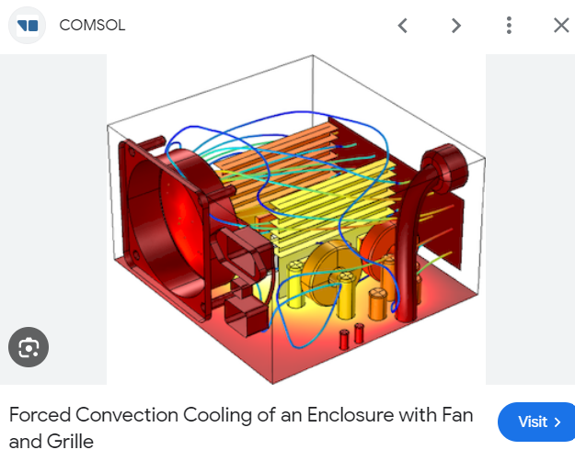
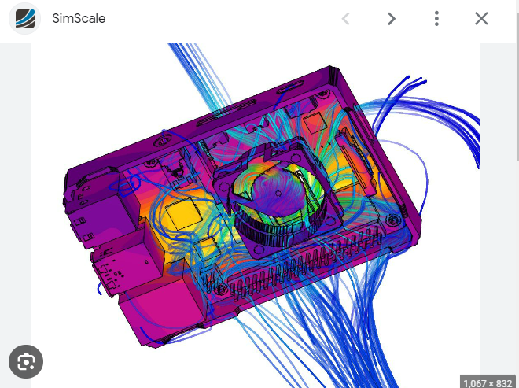
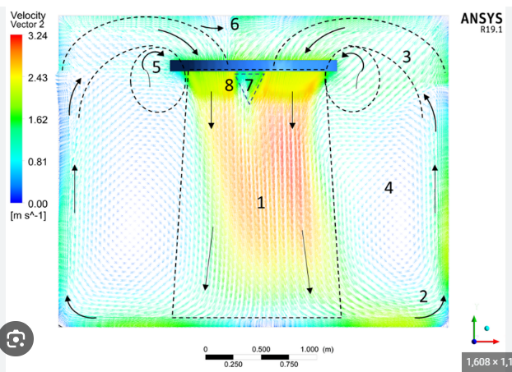
Cooling the system:
https://www.youtube.com/watch?v=UoXRHexGIok
https://www.youtube.com/watch?v=7uBNCN6v_gk 0:44
https://www.corsair.com/us/en/s/cpu-coolers-comparison
Cooling
Fans,
Heat sinks
Liquid cooling

Slide 18
Memory: RAM & Hard drive
https://www.corsair.com/us/en/s/corsair-memory
RAM: DDR4 or DDR5 memory
Hard drive: “the smart default pick with new motherboards is a solid-state boot drive in the M.2 format supporting PCI Express data transfers”. → These days, SSD

Slide 19
Power supply
https://www.corsair.com/us/en/s/psu-family
ATX power supply or for smaller cases SFX.
Fully wired power supply or modular power supply.

Slide 20
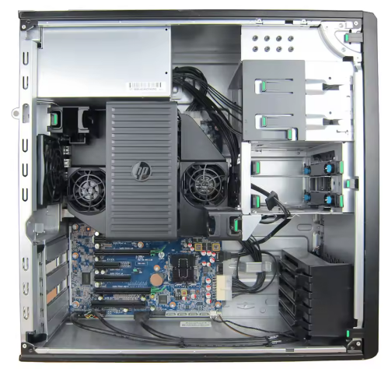
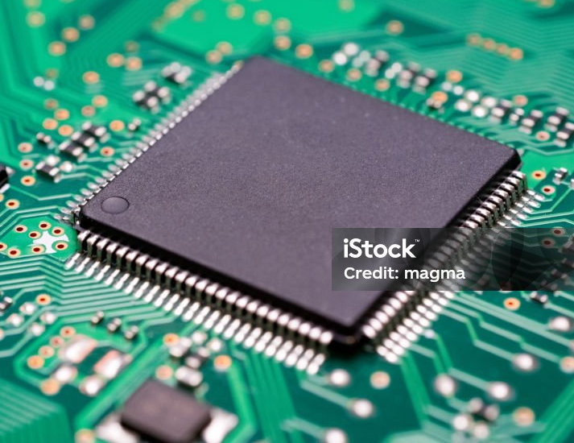
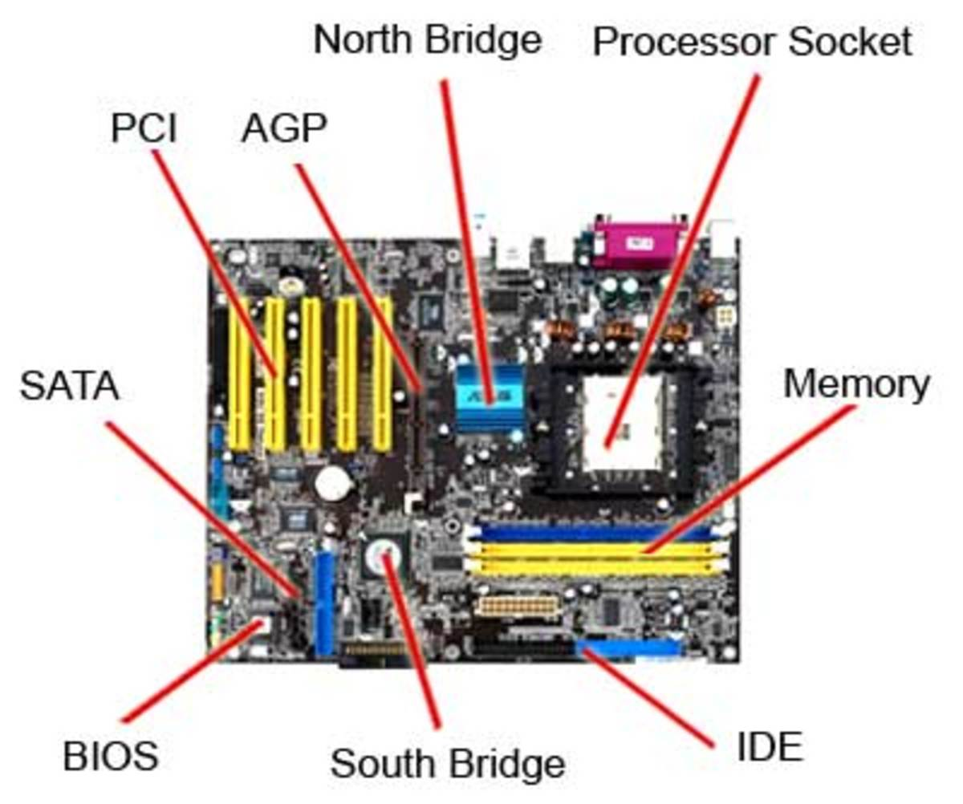
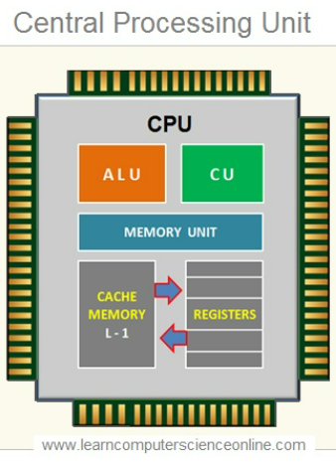
CPU:
Notes:
https://www.istockphoto.com/photo/printed-circuit-board-computer-foundation-cpu-gm2039814500-562597371?utm_campaign=srp_photos_top&utm_content=https%3A%2F%2Funsplash.com%2Fs%2Fphotos%2Fcpu&utm_medium=affiliate&utm_source=unsplash&utm_term=cpu%3A%3A%3A
https://discover.hubpages.com/technology/the-motherboard-components
https://www.alamy.com/stock-photo-pc-computer-open-atx-case-with-motherboard-and-other-hardware-installed-51750805.html?imageid=9874C638-4D68-4A0B-B081-8801F5272BD5&p=81180&pn=1&searchId=ca862c2d60fd8a0b49416e602e3f2185&searchtype=0
https://www.learncomputerscienceonline.com/central-processing-unit/
https://superuser.com/questions/1058555/is-it-possible-to-get-an-internal-usb-port-into-my-notebook

Slide 21
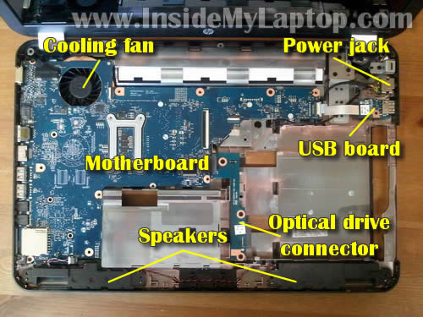

Slide 22
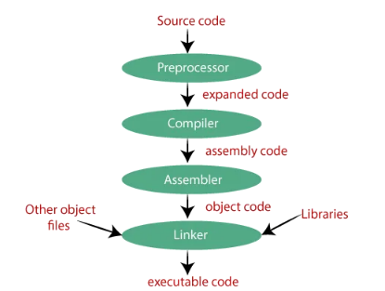



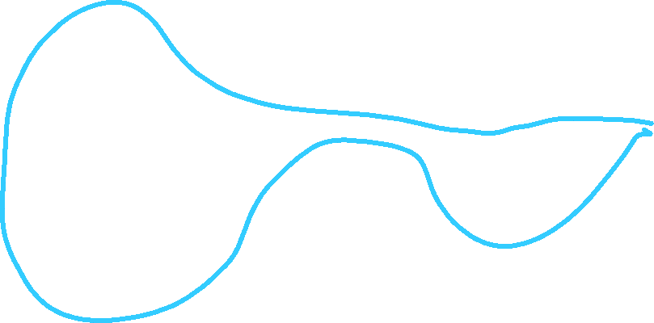
Course map
Signals between components:
Data
Numbers ①
Digital circuits
Gates
Boolean logic
Truth tables
K-Maps ②
Compilers ③
Languages/Instructions Hardware
Assembly
Machine language
Architecture Hardware ④
Memory ⑤
Addressing schemes
Memory mapped I/O
From Assembly
From C ⑥
Notes:
AGP (Accelerated Graphics Port) for graphics cards. Not on most new boards.
IDE (Integrated Drive Electronics), also known as PATA (Parallel ATA), was a standard interface for connecting storage devices like hard drives and optical drives to a motherboard before being replaced by SATA (Serial ATA).
SATA (Serial Advanced Technology Attachment) is a computer interface used for connecting storage devices like hard drives and solid-state drives (SSDs) to a motherboard. Still widely used in desktop and laptop computers. Gradually being supplemented by faster interfaces like M.2 NVMe for SSDs.
PCI (Peripheral Component Interconnect) is a standard computer bus interface for connecting various hardware components to a motherboard. Replaced older bus standards like ISA (Industry Standard Architecture). Gradually superseded by PCI-X and then PCIe (PCI Express).
The North Bridge (also called the Memory Controller Hub or MCH) is a critical component on a motherboard that acts as a high-speed connection hub for the most important system components. Connects the CPU to high-speed components. Manages communications between the processor, RAM, and graphics card.
The South Bridge (also called the I/O Controller Hub or ICH) is a motherboard component that manages slower-speed input/output (I/O) functions and peripheral connections. Handles communication for less critical system components. Connects to various slower-speed interfaces and ports.

Slide 23
Representing Numbers & Data

Slide 24
Internal digital representation of NUMBERS
A wire can be 0V or 5V, OFF or ON, LOW or HIGH. These respectively are represented as LOGIC ‘0’ (zero or FALSE) and ‘1’ (one or TRUE).
Each wire or memory cell represents a bit:
A bit (BInary digiT) is one of these values
REMEMBER: Computers stores all values as 1s and 0s!
Pictures
Numbers
Instructions
Characters / words
Data

Slide 25
Decimal = Base-10
Let’s say you have a number base-10: 298.460
Maximum digit value = Base – 1 = 10 – 1 = 9
Shorthand 298.460 ➔ 298.460₁₀
10⁴ | 10³ | 10² | 10¹ | 10⁰ | . | 10⁻¹ | 10⁻² | 10⁻³
0 | 0 | 2 | 9 | 8 | . | 4 | 6 | 0
0x10⁴ | 0x10³ | 2x10² | 9x10¹ | 8x10⁰ | . | 4x10⁻¹ | 6x10⁻² | 0x10⁻³
0x10⁴+0x10³+2x10²+9x10¹+8x10⁰+4x10⁻¹+6x10⁻²+0x10⁻³
Notes:
Implicit zeroes

Slide 26
“Bits” Base-2 (Positive Binary)
Let’s say you have a number base-2: 00110.110₂
Maximum digit value = Base – 1 = 2 – 1 = 1
Write 00110.110₂ In Base-10:
=0+0+2²+2¹+0+2⁻¹+2⁻²+0
=0+0+4 +2+0+1/2+1/4+0=6.75₁₀
2⁴ | 2³ | 2² | 2¹ | 2⁰ | . | 2⁻¹ | 2⁻² | 2⁻³
0 | 0 | 1 | 1 | 0 | . | 1 | 1 | 0
0x2⁴ | 0x2³ | 1x2² | 1x2¹ | 0x2⁰ | . | 1x2⁻¹ | 1x2⁻² | 0x2⁻³
OFF | OFF | ON | ON | OFF |  | ON | ON | OFF
0x2⁴ +0x2³ +1x2² +1x2¹ +0x2⁰ +1x2⁻¹ +1x2⁻² +0x2⁻³

Slide 27
Class problem 0
Convert 0101₂ to base 10
Convert 0101.01₂ to base 10

Slide 28
Example: Translate 652.625₁₀ to binary (1) (Left of decimal point done on this slide)
Powers of 2 for positive powers:
Take integer part: 652
Find largest power of 2 and subtract:
652-512=140 (1x2⁹)
Find largest power of 2 and subtract:
140-128=12 (1x2⁷)
Find largest power of 2 and subtract:
12-8=4 (1x2³)
Find largest power of 2 and subtract:
4-4=0 (1x2²)
2¹⁰ | 2⁹ | 2⁸ | 2⁷ | 2⁶ | 2⁵ | 2⁴ | 2³ | 2² | 2¹ | 2⁰
1024 | 512 | 256 | 128 | 64 | 32 | 16 | 8 | 4 | 2 | 1
2¹⁰ | 2⁹ | 2⁸ | 2⁷ | 2⁶ | 2⁵ | 2⁴ | 2³ | 2² | 2¹ | 2⁰
0 | 1 | 0 | 1 | 0 | 0 | 0 | 1 | 1 | 0 | 0

Slide 29
Example: Translate 652.625₁₀ to binary (2) (Right of decimal point done on this slide)
Powers of 2 for positive powers:
Take decimal part: 0.652
Find largest power of 2 and subtract:
0.625-0.5=0.125 (1x2⁻¹)
Find largest power of 2 and subtract:
0.125-0.125=0 (1x2⁻³)
Final value of 652.625₁₀ is:
2⁻¹ | 2⁻² | 2⁻³ | 2⁻⁴ | 2⁻⁵
0.5 | 0.25 | 0.125 | 0.0625 | 0.03125
2⁻¹ | 2⁻² | 2⁻³ | 2⁻⁴ | 2⁻⁵
1 | 0 | 1 | 0 | 0
This slide
Previous slide
2¹⁰ | 2⁹ | 2⁸ | 2⁷ | 2⁶ | 2⁵ | 2⁴ | 2³ | 2² | 2¹ | 2⁰ | . | 2⁻¹ | 2⁻² | 2⁻³ | 2⁻⁴ | 2⁻⁵
0 | 1 | 0 | 1 | 0 | 0 | 0 | 1 | 1 | 0 | 0 | . | 1 | 0 | 1 | 0 | 0

Slide 30
Example: Translate 652.625₁₀ to binary (3)
Translate 652.625₁₀ to binary
652.625₁₀ = 01010001100.10100₂
To represent this number in a digital system you need 16 bits, 16 wires, 16 memory cells or 16 somethings…
2¹⁰ | 2⁹ | 2⁸ | 2⁷ | 2⁶ | 2⁵ | 2⁴ | 2³ | 2² | 2¹ | 2⁰ | . | 2⁻¹ | 2⁻² | 2⁻³ | 2⁻⁴ | 2⁻⁵
0 | 1 | 0 | 1 | 0 | 0 | 0 | 1 | 1 | 0 | 0 | . | 1 | 0 | 1 | 0 | 0

Slide 31
Class problems 1
Convert 43.125₁₀ to binary
Convert 13.1875₁₀ to binary
Convert 444.44₁₀ to binary (limited to 3 numbers to the right of the binary point)

Slide 32
Translate 01101.010₂ to base-10
01101.010₂ =
2⁴ | 2³ | 2² | 2¹ | 2⁰ | . | 2⁻¹ | 2⁻² | 2⁻³
0 | 1 | 1 | 0 | 1 | . | 0 | 1 | 0
0x2⁴+1x2³+1x2²+0x2¹+1x2⁰+0x2⁻¹+1x2⁻²+0x2⁻³ =
0 + 8 + 4 + 0 + 1 + 0 + 0.25 + 0 =13.25₁₀

Slide 33
Class problem 2
Convert 001011.101₂ to decimal
Convert 101.01₂ to decimal

Slide 34
Today
Prep
Do homework
Today:
More numbers
How to build digital circuits

Slide 35
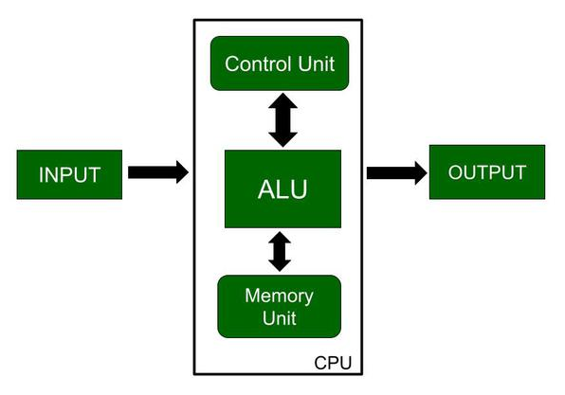
1/27
Homework 2 to be posted tonight
Report due for lab

Slide 36
Course map
Signals between components:
Data
Numbers ①
Digital circuits
Gates
Boolean logic
Truth tables
K-Maps ②
Compilers ③
Languages/Instructions Hardware
Assembly
Machine language
Architecture Hardware ④
Memory ⑤
Addressing schemes
Memory mapped I/O
From Assembly
From C ⑥
Notes:
AGP (Accelerated Graphics Port) for graphics cards. Not on most new boards.
IDE (Integrated Drive Electronics), also known as PATA (Parallel ATA), was a standard interface for connecting storage devices like hard drives and optical drives to a motherboard before being replaced by SATA (Serial ATA).
SATA (Serial Advanced Technology Attachment) is a computer interface used for connecting storage devices like hard drives and solid-state drives (SSDs) to a motherboard. Still widely used in desktop and laptop computers. Gradually being supplemented by faster interfaces like M.2 NVMe for SSDs.
PCI (Peripheral Component Interconnect) is a standard computer bus interface for connecting various hardware components to a motherboard. Replaced older bus standards like ISA (Industry Standard Architecture). Gradually superseded by PCI-X and then PCIe (PCI Express).
The North Bridge (also called the Memory Controller Hub or MCH) is a critical component on a motherboard that acts as a high-speed connection hub for the most important system components. Connects the CPU to high-speed components. Manages communications between the processor, RAM, and graphics card.
The South Bridge (also called the I/O Controller Hub or ICH) is a motherboard component that manages slower-speed input/output (I/O) functions and peripheral connections. Handles communication for less critical system components. Connects to various slower-speed interfaces and ports.

Slide 37
Representations: Hexidecimal (base-16)
The average person can hold between three and seven items in their short-term memory, also known as working memory. This limit is known as the "magical number seven"
Binary: 01011101101010101.00111101
All ones and zeroes
Not human friendly
Hexadecimal
Group 4-bits together from decimal point
4-bits can equal more than 9.
00001011101101010101.00111101
0 B B 5 5 . 3 D = 0xBB55.3D
Decimal | 0 | 1 | 2 | 3 | 4 | 5 | 6 | 7 | 8 | 9 | 10 | 11 | 12 | 13 | 14 | 15
Base-2 | 0000 | 0001 | 0010 | 0011 | 0100 | 0101 | 0110 | 0111 | 1000 | 1001 | 1010 | 1011 | 1100 | 1101 | 1110 | 1111
Hex | 0 | 1 | 2 | 3 | 4 | 5 | 6 | 7 | 8 | 9 | A | B | C | D | E | F

Slide 38
Representations: Octal (Base-8) (Included for completeness but we won’t use)
Binary: 01011101101010101.00111101
All ones and zeroes
Not human friendly
Octal
Group 3-bits together from decimal point
01011101101010101.00111101
1 3 5 5 2 5 . 1 7 2 = 135525.172₈
0 0

Slide 39
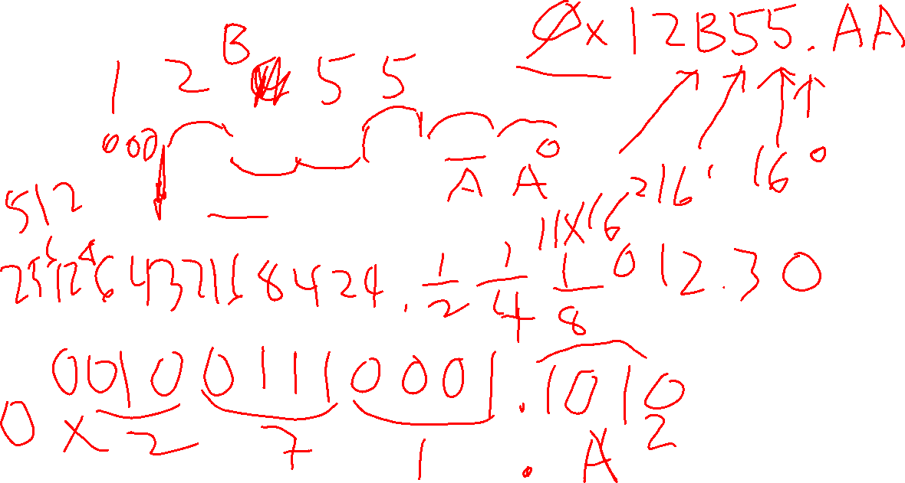
Class problems 3
What is the hexadecimal representation of 10010101101010101.1010101₂?
625.625₁₀ in hex
What’s missing?

Slide 40
Representing negative numbers (1)
Five ways to represent negative numbers (Four numerical ways):
Sign-magnitude
Easy for humans but not so good for math
1’s complement
Better for math but wasteful
2’s complement ➔ The main one we’ll be looking at
Usually used. Computers like it, not wasteful.
BCD (Binary-coded decimal)
Humans like it. Computers… Not so much. Math hard.
ASCII, JIS X 0208, EUC (Unix), Unicode, etc.
Text characters

Slide 41
WORD: Wikipedia
In computing, word is a term for the natural unit of data used by a particular computer design. A word is simply a fixed-sized group of bits that are handled together by the system. The number of bits in a word (the word size or word length) is an important characteristic of a computer architecture.

Slide 42
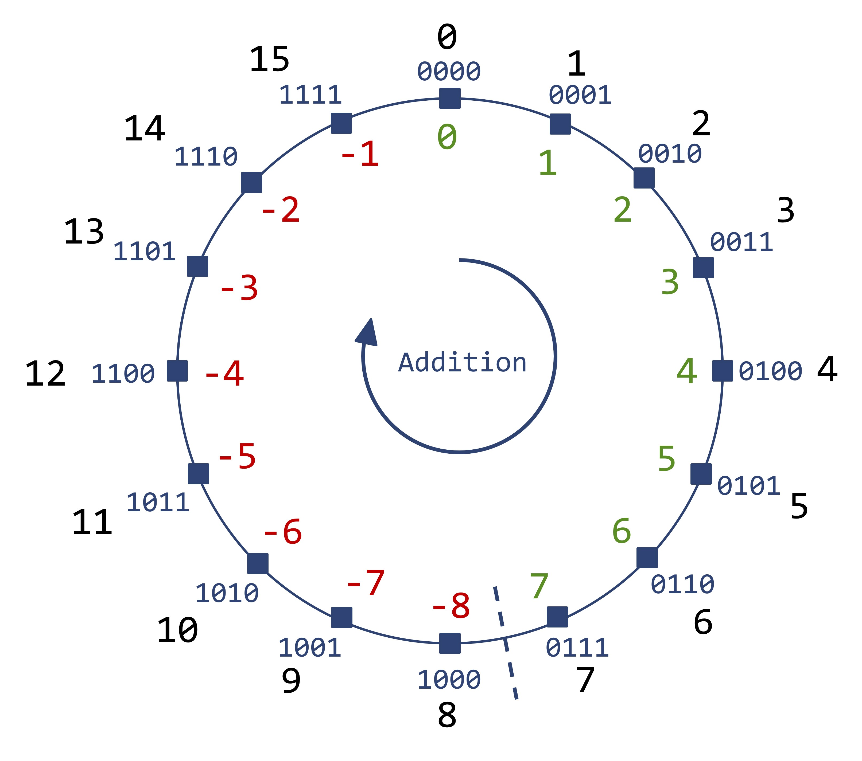
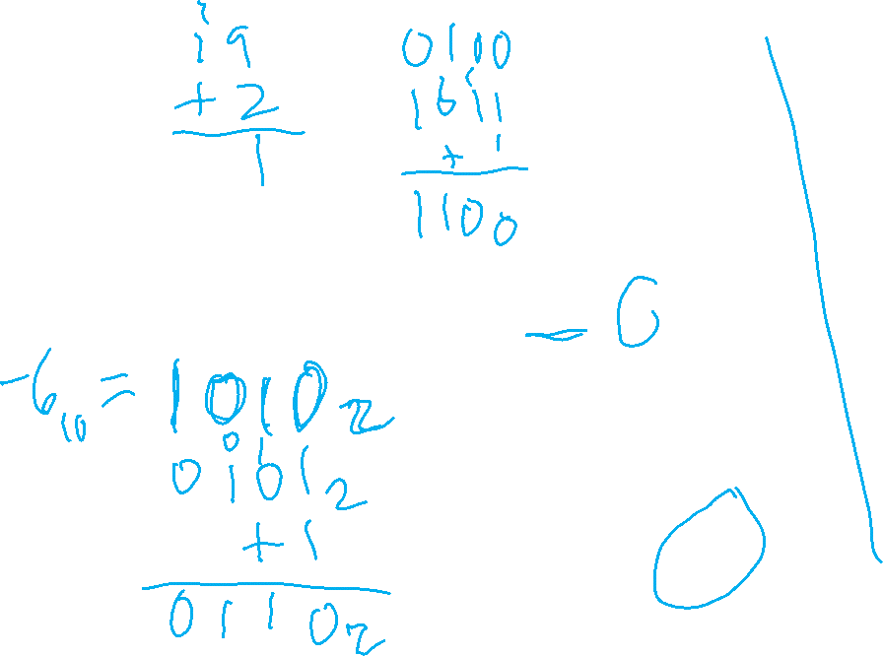
2’s complement in picture form

Slide 43
Sign-magnitude Representation (1) (Included for completeness but we won’t use)
Let’s pick a number: 27₁₀ = 00011011₂ = 0x1B
Sign-magnitude says the top bit, the most significant bit (MSB*), the leftmost bit is a sign bit
If the sign bit is “1”, then the number is negative
If the sign bit is “0”, then the number is positive
So….
00011011₂ = 27₁₀
AND
10011011₂ = -̶27₁₀
*LSB is the least significant bit and the bit farthest to the right.
Notes:
8-bit number. Can be any number of bits.

Slide 44
Sign-magnitude Representation (2) (Included for completeness but we won’t use)
A closer look at S/M representation
Question: What is zero?
00000000₂ = 0₁₀
AND
10000000₂ = -̶0₁₀
Two zeroes… That’s a waste of a value.
Later we’ll see that S/M is hardest to use in addition and multiplication of binary numbers.
Number range from: -127 to 127

Slide 45
One’s complement Representation (1) (Included for completeness but we won’t use)
Let’s pick a number: 27₁₀ = 00011011₂ = 0x1B
One’s complement says the negative value is just the “complement”. All 1s are changed to zero and all zeroes are changed to ones.
So….
00011011₂ = 27₁₀
AND
11100100₂ = -̶27₁₀

Slide 46
One’s complement Representation (2) (Included for completeness but we won’t use)
Question: What is zero?
00000000₂ = 0₁₀
AND
11111111₂ = -̶0₁₀
Two zeroes… That’s also a waste of a value.
Later we’ll see that 1’s comp is still a little complicated to use in addition and multiplication of binary numbers but quite a bit easier than SM.

Slide 47
One’s complement Representation (3) (Included for completeness but we won’t use)
What about the number 255₁₀?
11111111₂ = 255₁₀
Invert everything and… 00000000₂ = 0₁₀
Oops…
It turns out that 1’s comp only works for values between: −(2^{N−1}−1) to (2^{N−1}−1) where N is the number of bits. (Same as S/M)
Here N=8 so values range from –(2⁷-1) to 2⁷-1 or -127 to 127
A closer look will tell you that the MSB tells you if a 1’s comp number is positive or negative

Slide 48
Two’s complement Representation (1) THIS IS THE MOST IMPORTANT REPRESENTATION
Positive numbers are the same for positive binary and for positive 2’s complement numbers.
Let’s pick a number: 27₁₀ = 00011011₂ = 0x1B
Two’s complement says the negative value is just the “complement plus 1”. All 1s are changed to zero and all zeroes are changed to ones then 1 is added.
So….
00011011₂ = 27₁₀
AND
11100100₂ + 1 = 11100101₂ = -̶27₁₀

Slide 49
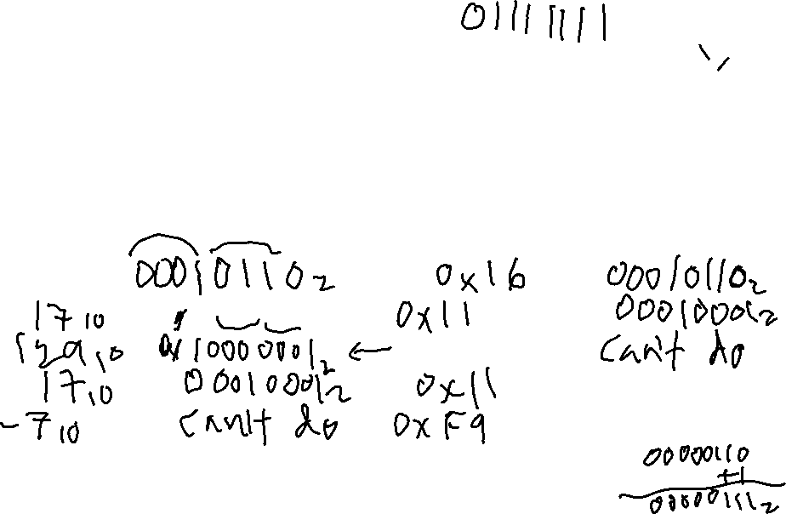
Class problems 4
Fill in the following table
All answers in 8-bits except base-10
If a number can’t be represented, write “X” or “?”
Base-10 | Positive binary | Hexadecimal | 2’s complement
22₁₀
 | 00010001₂
 |  | 0x81
 |  |  | 00010001₂
 |  |  | 11111001₂

